Slide 1
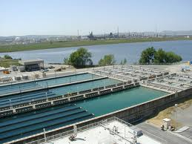
Dealing with Tough Water Issues
Jim Miller
Aqua Aid/Verde-Cal

Slide 2
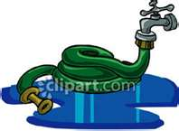
What stands out on this test?
What problems can exist to turf?
What problems can exist to the soil?
What about nutrient availability?
Sometimes bad looking water isn’t so bad?
Sometimes it is. But how do you know?
How can you educate your customer
Better than your competitor?
How can you help your customer grow
Better turf?

Slide 3
Where do we focus our attention on a water test?
Negative influences in water: What are they?
Bicarbonates
Chlorides
Sodium Absorption Ratio
Electrical conductivity
Sodium
Sulfate
pH
Most of these negative inputs, if high enough, will cause all positive influences in the soil to be negative influences instead. This leads to lack of color, poor nutrient absorption, wilt, disease, other stresses, lack of drainage, poor pesticide results, etc…….

Slide 4
Water made simple.
Arizona State University table of infiltration potential

Slide 5
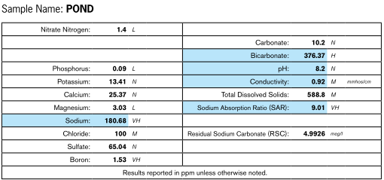

Slide 6
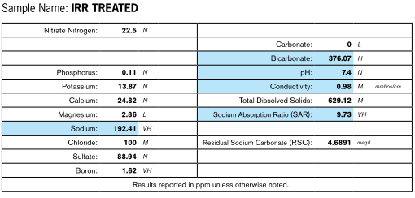
We have improved the water in the last sample. Now how does this water look? Is it free from problems? Are we done?

Slide 7
SAR: 9.73
EC: .92
Bicarbonates: 376.07
pH: 7.4

Slide 8
Let’s pretend the water from the last slide is inside the pipe. And this is the pipe
That surrounds our customers turf area and ultimately goes through the sprinkler
And waters the turf. Questions to ask:
Where are the bicarbonates?
Where is the high pH water?
Where is the EC?
Where is the SAR?
The answer is: All those negative influences are going right into the soil and
Ultimately causing soil problems, which cause turf problems.
The injection of sulfuric acid products only will do so much!
There is still a HUGE need for soil amending with calcium, as well as other essential cations!

Slide 9
Summary so far:
When dealing with poor water issues you have to “think outside the box”… (or outside the pipe) Why?
Because there are influences in the water that are going to create poor soil conditions.
The worse the water problem, the more soil amending will be needed. Sometimes this can be shocking to your customer!
Liquid calcium products will be in-effective. Why?
More nutrient: K, Ca, sometimes Mg will be needed in the soil! Volume is the key!
Aeration becomes VERY important

Slide 10
How does Verde-Cal G and AcidipHy fit in?
Both create soluble calcium and acidify the soil and more importantly the soil solution.
Both have the ability to lower pH. Or hold pH.
Both release nutrient. Goodies that is already there.
Both create color
Both help flocculate the soil and solution.
Both are the KEY to “finishing the treatment story.”
Where Acid Injection leaves off, Verde-Cal G and AcidipHy finish the job of buffering the soil and solution.

Slide 11
When we address the soil
With available calcium, potash
And magnesium, look what
Happens to :
Bicarbonates
Calcium
Magnesium
Potash
Sodium
pH
We “think outside the pipe” and
Great things happen!

Slide 12
Program approach in the Mid Atlantic region
Date | Product | Rate/1000 | Rate/acre | Cost/Acre
April | Verde-Cal G | 10# | 444 # | $228.00
May | AcidipHy | 12-15#** | 528-660# | $440-$554
June/July | Verde-Cal G | 5-8# | 220 - 350 | $114 – 182
August | AcidipHy | 12-15#** | 528-660 | $440-$554
October | Verde-Cal G | 5-8# | 220-350 | $114-$182
A greens program based on three acres will run about $2820.00 to $5100.00 per year.
** the worse the water, the higher the rate needs to be on AcidipHy.

Slide 13
Verde-Cal G and AcidipHy…
To conclude… To really fix bad water situations, it can be shocking to your customer what it will take to do the job right.
Your competition doesn’t understand this chemistry and soil science.
Your customers need the best advice!

